Slide 1

On-Campus Job Management System
DAMG Group 15
Dinesh Reddy Potlapati
Jinal Mamaniya
Sai Kiran Reddy Konda
Tarun Balwani
Zeenia Singla

Slide 2

Why On-Campus Job Management System ?
Student with zero jobs will be given priority
Student can apply to many jobs irrespective of their job status
Transparency between applicant and employer regarding jobs

Slide 3
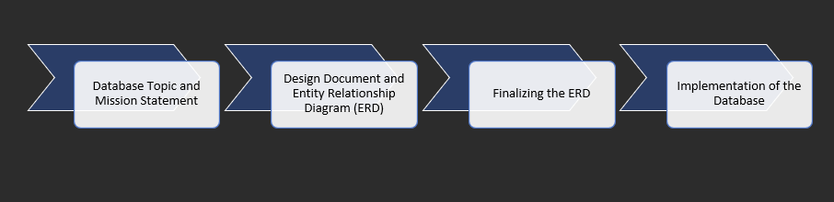
PHASE Diagram

Slide 4

ENTITY RELATIONSHIP DIAGRAM

Slide 5
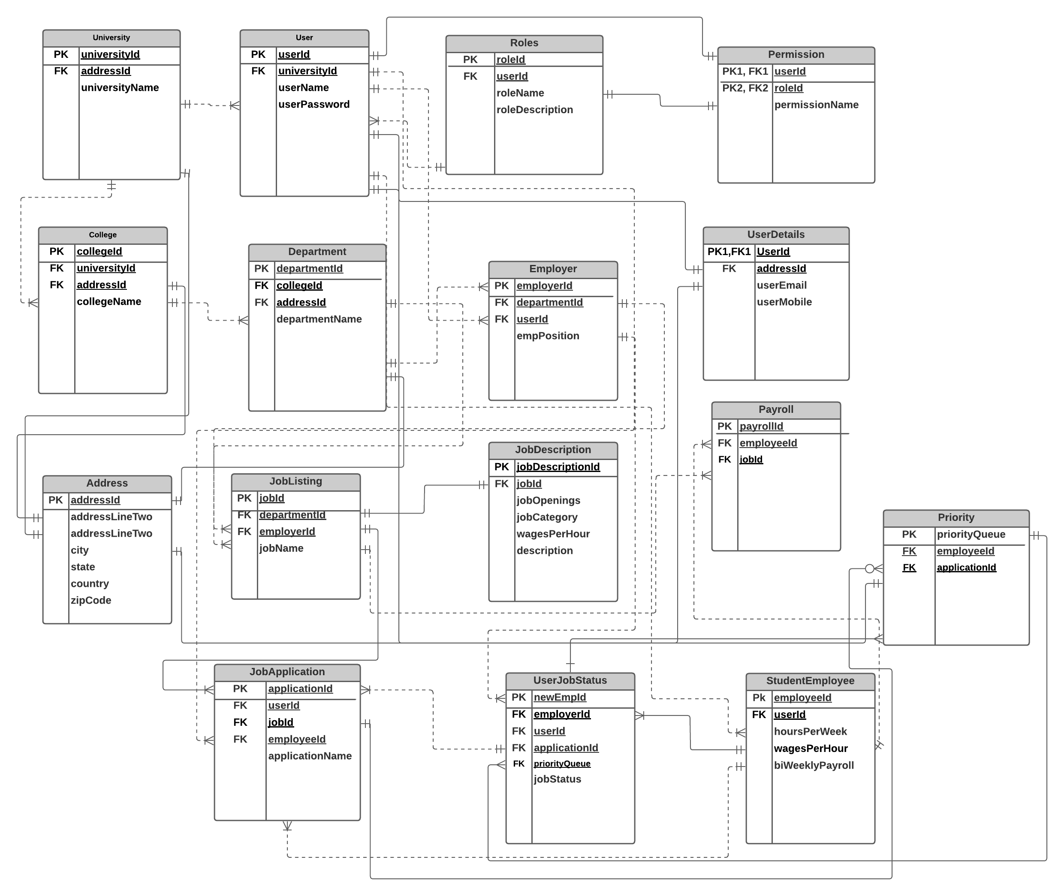

Slide 6

Data implementation

Slide 7
Create Table
dbo.University | dbo.JobDescription
dbo.Users | dbo.Address
dbo.Roles | dbo.Employer
dbo.Permission | dbo.JobApplication
dbo.UserDetails | dbo.UserJobStatus
dbo.College | dbo.StudentEmployee
dbo.Department | dbo.Payroll
dbo.JobListing | dbo.Priority

Slide 8
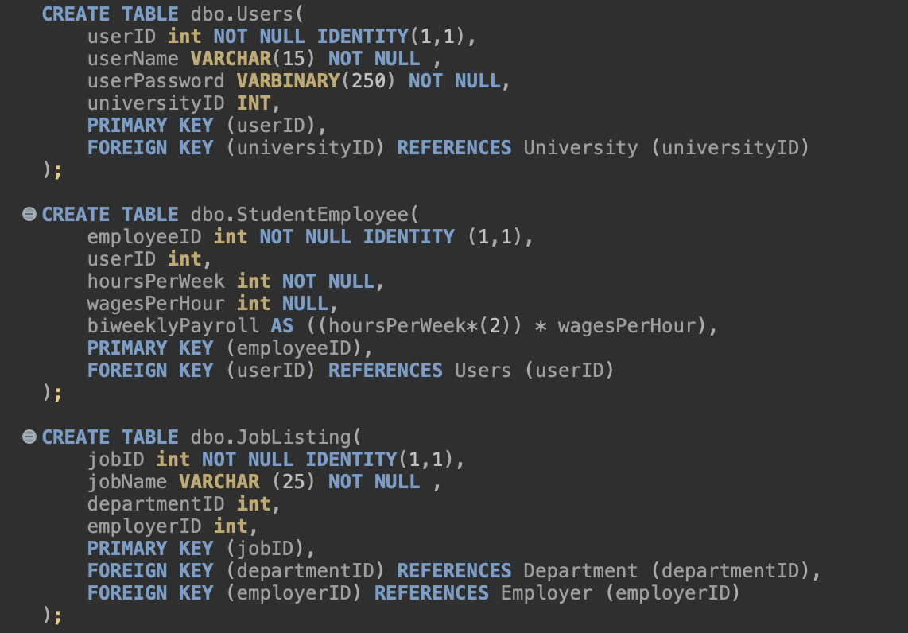
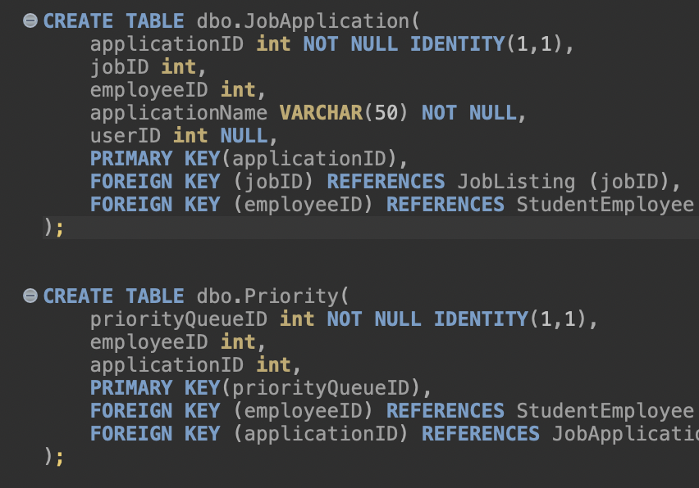

Slide 9
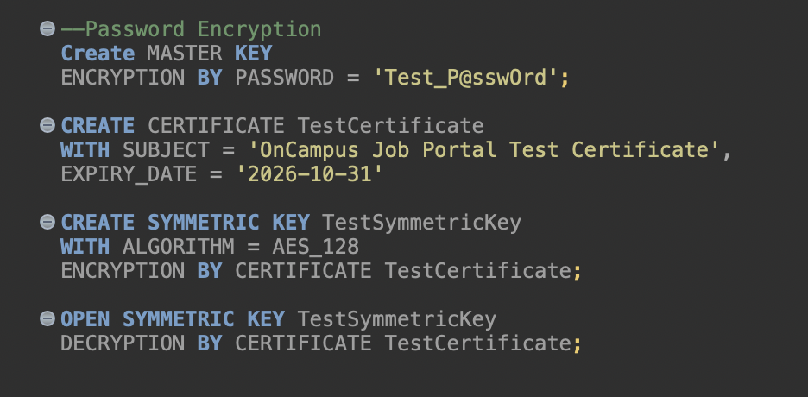
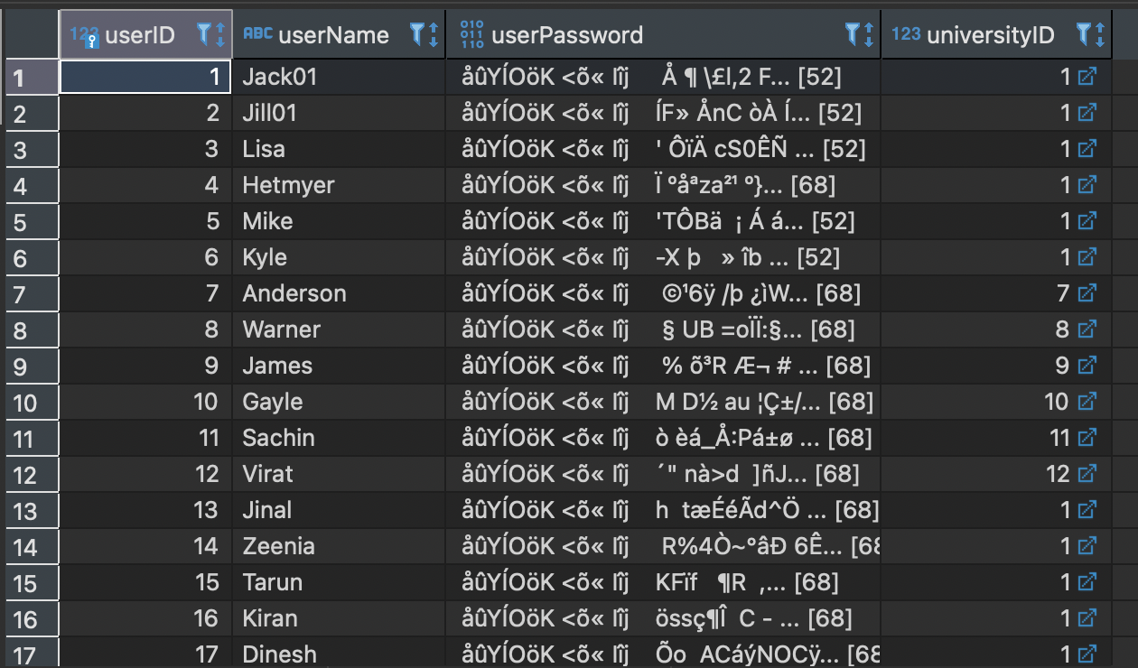
Data encryption for password

Slide 10

Computational column
ALTER TABLE dbo.StudentEmployee
ADD biweeklyPayroll AS (hoursPerWeek * 2 * wagesPerHour)

Slide 11
Functions/check constraint - 1
CREATE FUNCTION chk_same_job_application(@jobID int, @userID int)
RETURNS BIT
AS
BEGIN
IF(SELECT COUNT(*) FROM dbo.JobApplication WHERE jobID = @jobID AND userID = @userID) > 1
BEGIN
RETURN 1
END
RETURN 0
END
ALTER TABLE dbo.JobApplication
WITH NOCHECK ADD CONSTRAINT chk_duplicate_job_application CHECK (dbo.chk_same_job_application(JobApplication.jobID,JobApplication.userID) = 0);

Slide 12
Functions/check constraint - 2
CREATE FUNCTION chk_duplication_username (@user_name VARCHAR(50))
RETURNS bit
AS
BEGIN
IF (SELECT count(*) FROM dbo.users WHERE users.username = @user_name) > 1
BEGIN
RETURN 1
END
RETURN 0
END
ALTER TABLE dbo.Users WITH NOCHECK add CONSTRAINT chk_duplicate1 CHECK (dbo.chk_duplication_username(Users.userName) = 0);

Slide 13
trigger
CREATE TRIGGER tr_jobApplication
ON JobApplication
AFTER INSERT,UPDATE
AS BEGIN
DECLARE @user_uni_id int;
DECLARE @employer_uni_id int;
SELECT @user_uni_id = u.universityID from Users u
INNER JOIN INSERTED i on i.userID = u.userID
SELECT @employer_uni_id = u.universityID FROM INSERTED i
inner join JobListing jl on i.jobID = jl.jobID
inner join Employer e on jl.employerID = e.employerID
inner join Users u on e.userID = u.userID
IF @user_uni_id <> @employer_uni_id
RAISERROR('You Cannot Apply to this Job',16,1)
END

Slide 14
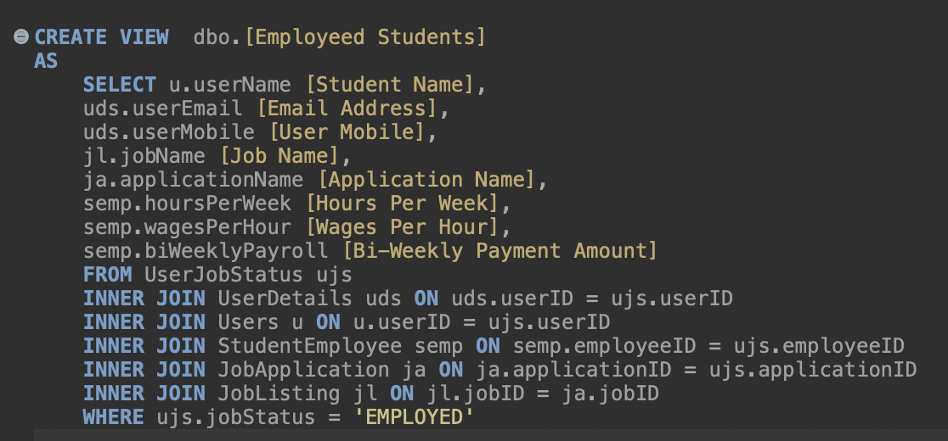
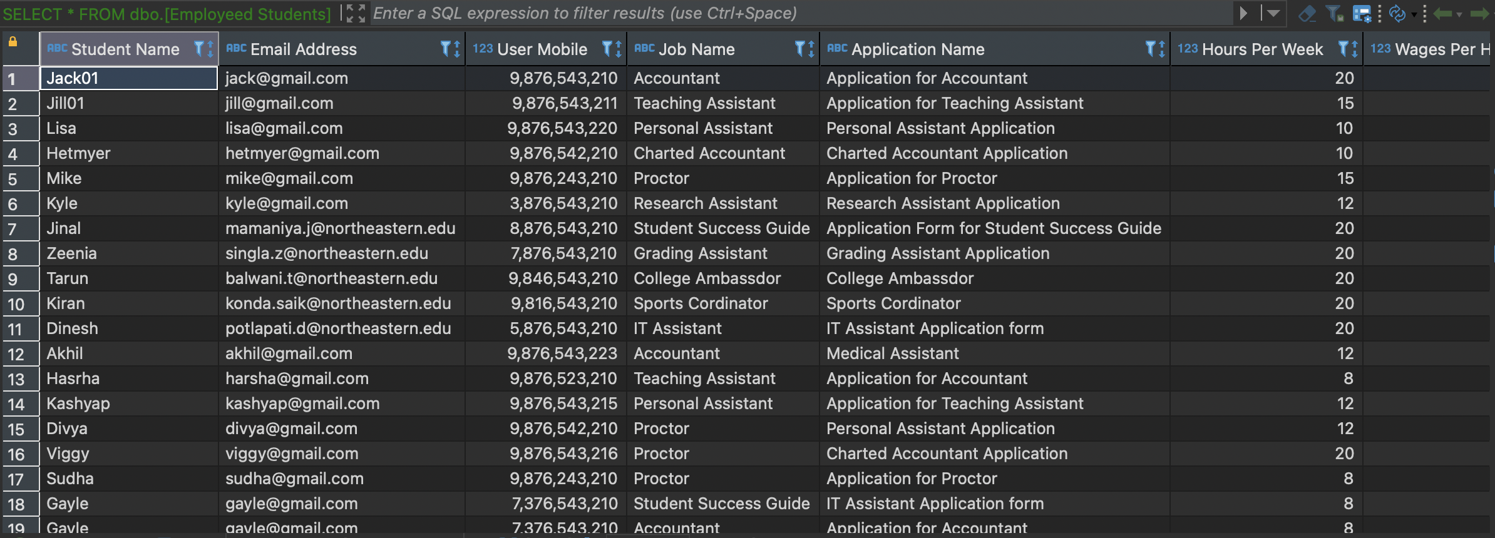
Data implementation view 1
.
SELECT * FROM dbo.[Employeed Students]

Slide 15
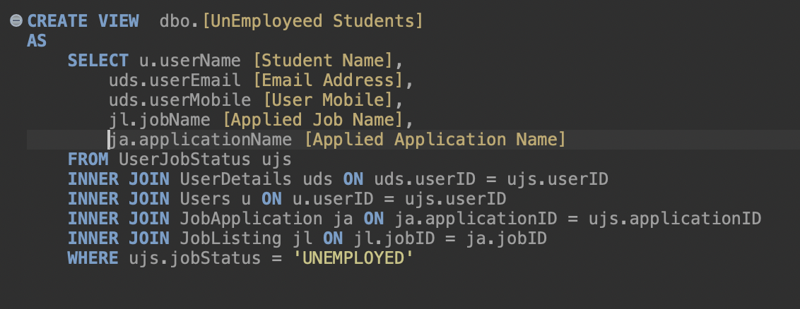
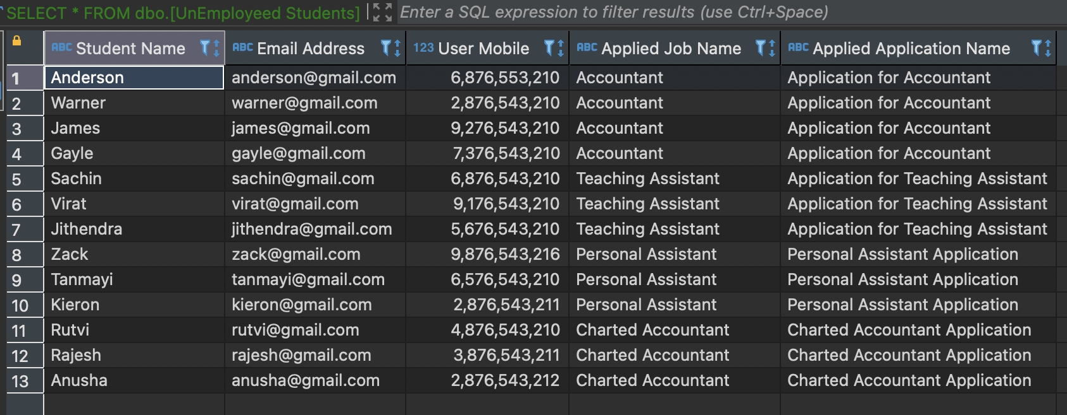
Data implementation – view 2
SELECT * FROM dbo.[UnEmployeed Students]

Slide 16
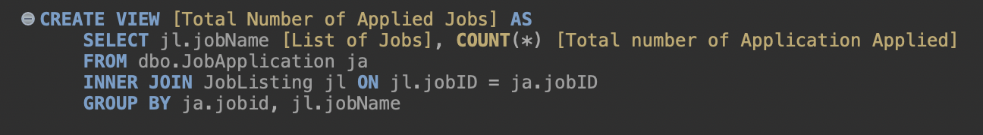
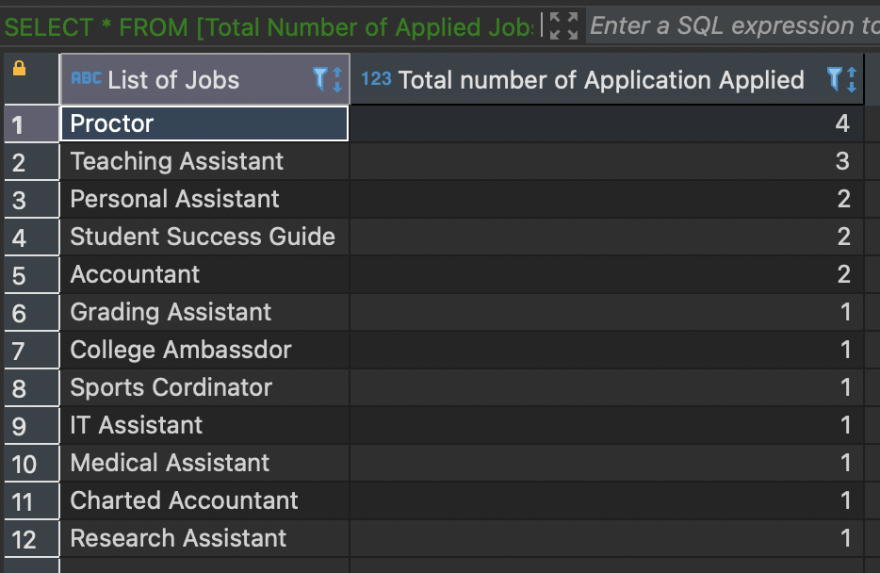
Data implementation view 3
SELECT * FROM [Total Number of Applied Jobs] ORDER BY [Total number of Application Applied] DESC

Slide 17

Data visualization

Slide 18
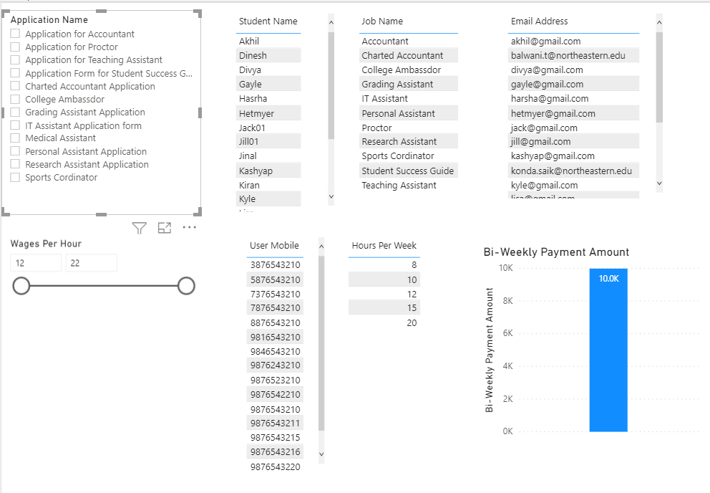
Number of Students Employed

Slide 19
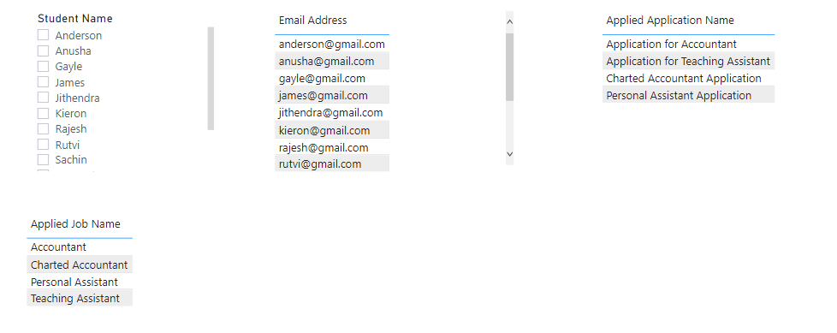
Number of Students UNEmployed

Slide 20
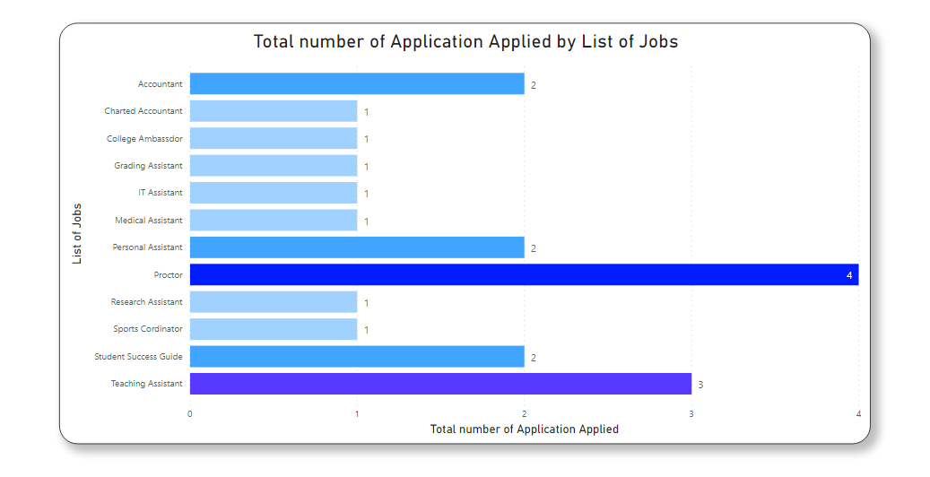
Total jobs applied

Slide 21
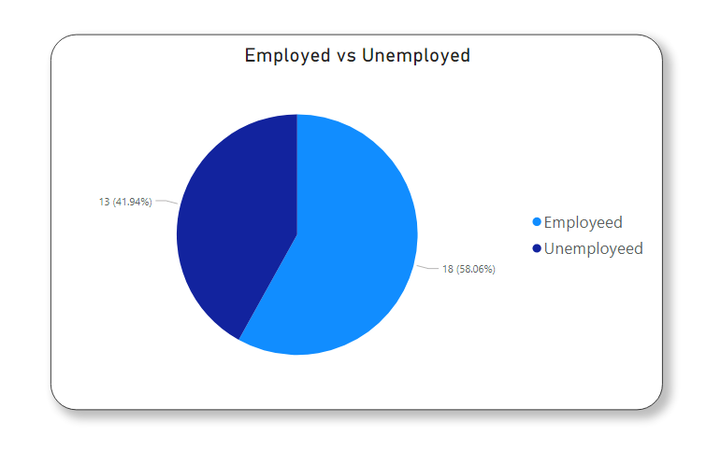

Slide 22
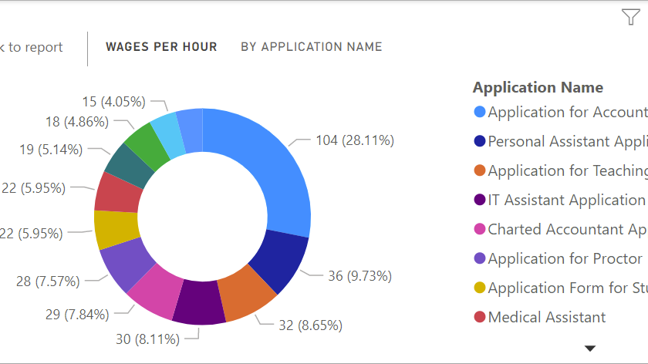
Wages distribution per job

Slide 23
Thank you

